Slide 1
Smart Terrestrial Warehouse Robot Deployment

Slide 2
Problem Statement
The main objective of the project is to create for each store of Caratlane, we have a different amount of inventory. And all ou rinventory is recorded in our system. In this system, we have the product image,bar code, price, and other information related to an available product. In the store, we have the physical product along with their bar-code tags and SKUcodes.
Whenever a sale happens, the sold product is archived from the system.Now the issue is, we do not have a register (or such) for where the product is located in the store room. Which rack and which row of which rack? Stock Reconciliation, which is whether the inventory that is mentioned in the system is present in the store as well. It's a manual and long process that we do every day to ensure all the products are available.
Problems to be addressed are mentioned as follows :-
1. Smart counting of stocks and verifying it against the system,
2. Automatic identification of the availability of a particular piece/item against the racks in our physical store.

Slide 3
Project Overview and Objective
With the advent fourth industrial revolution due to Robotics and AI, the field of inventory management and logistics is also catching up. Many large warehouses all over the world are using Robots and AI to automate the time and labour intensive tasks of inventory management. We hope to use such technologies in our solution for this problem statement. Here’s how our idea will work:
1. An autonomous and robust rover capable of traversing the complete inventory yard and equipped with sensors like a camera, GPS, etc. will be used for all the labor-intensive tasks like going in the field and counting.
2. A custom computer vision algorithm deployed in the rover’s software stack will be used to calculate the number of pipes in a stack using the camera’s video stream.
3. The rover will be capable to go on periodic counting missions or counting missions as per the requirement to update the inventory stats.
4. All these stats will be updated and visualized in real-time in a highly intuitive and detailed web dashboard.
5. Through this, we will be able to automate the whole inventory management process with almost no human involvement.

Slide 4
Salient Features
To create inventory management for steel pipes with the following capabilities:
1. Counting the gold products
2. Interactive dashboard for monitoring related data the product image,bar code, price, and other information related to an available product according to the Inventory location
3. Real-time monitoring for inventory rover
4. Instructing rover on a mission for counting stacks in an inventory area or configure rover to go on periodic counting missions.
5. Number of stacks counted and pending in inventory
6. Sensory data from inventory rover
7. Accuracy for counting the products

Slide 5
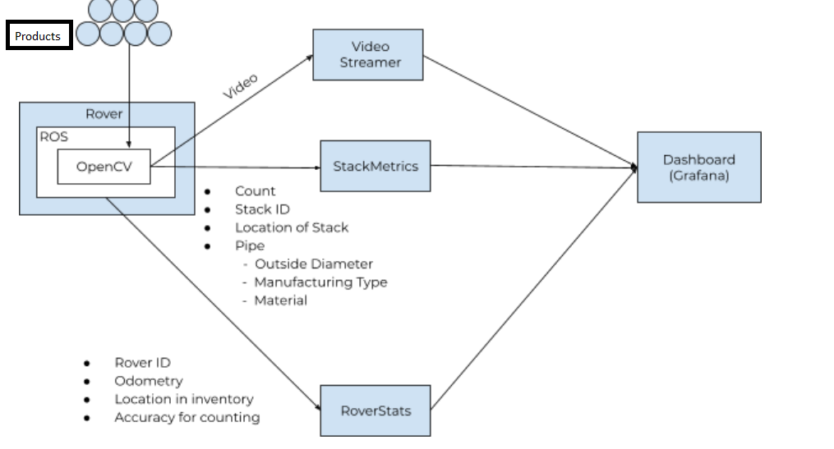
Architecture

Slide 6
Solution Approach
Rover runs on ROS (Robot operating system) which navigates autonomously in the whole inventory yard. When the rover detects an AR tag, a marker-based board signifying the start of a certain stack of products, it will start counting products in the stack. The rover implements circle detection and object tracking for the purpose of counting pipes with help of OpenCV and Tensorflow. Using ROS provides us with the fundamental advantage of modularity which will allow us to use the same software stack on any ROS-based rover and even drones! Rover is also responsible for following data alongside the count of the stack:
1. Video stream of a camera mounted on the rover
2. Stack metrics which will have the count, identification, location, and product data
3. Rover stats consist of data like product image,bar code, price, and other information related to an available product. In the store, the physical product along with their bar-code tags and SKUcodes. location in inventory, and accuracy for counting
Video Streamer Video streamer responsible for subscribing to the video stream from rover camera and then uploading it on the dashboard for real-time monitoring of the inventory as well as the rover.

Slide 7
Metrics
StackMetrics will be responsible for subscribing to stack-related metrics being published by the rover. Following are the attributes for the stack data:
Count of the products
Stack ID
Location of Stack
RoverStats will be responsible for subscribing to rover-related metrics. Following are the attributes for Rover data being published by ROS:
Rover ID
Odometry to track the position change in the product
Location in inventory
Accuracy for counting

Slide 8
Dashboard
The representation of data visualization works mostly on Grafana which reads data from the data source and shows all the above information intuitively, providing extra capabilities of data filtering and analytics too. The data points generated as part of the metrics for StackMetrics and RoverStats are dumped to the time-series database (InfluxDB) in real-time. Grafana reads from the time-series database and provides intuitive graphs to gain important insight and analytics on the StackMetrics and RoveStats

Slide 9
Technology Stack
● ROS (Robot Operating System)
● Python
● OpenCV
● Tensorflow
● Time Series DB (InfluxDB)
● Grafana

Slide 10
Demo Video
https://www.youtube.com/watch?v=Lo-DlvuUJwE&feature=youtu.be

